Slide 1
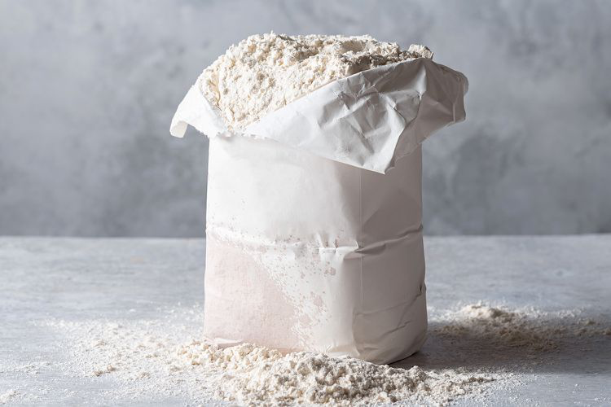
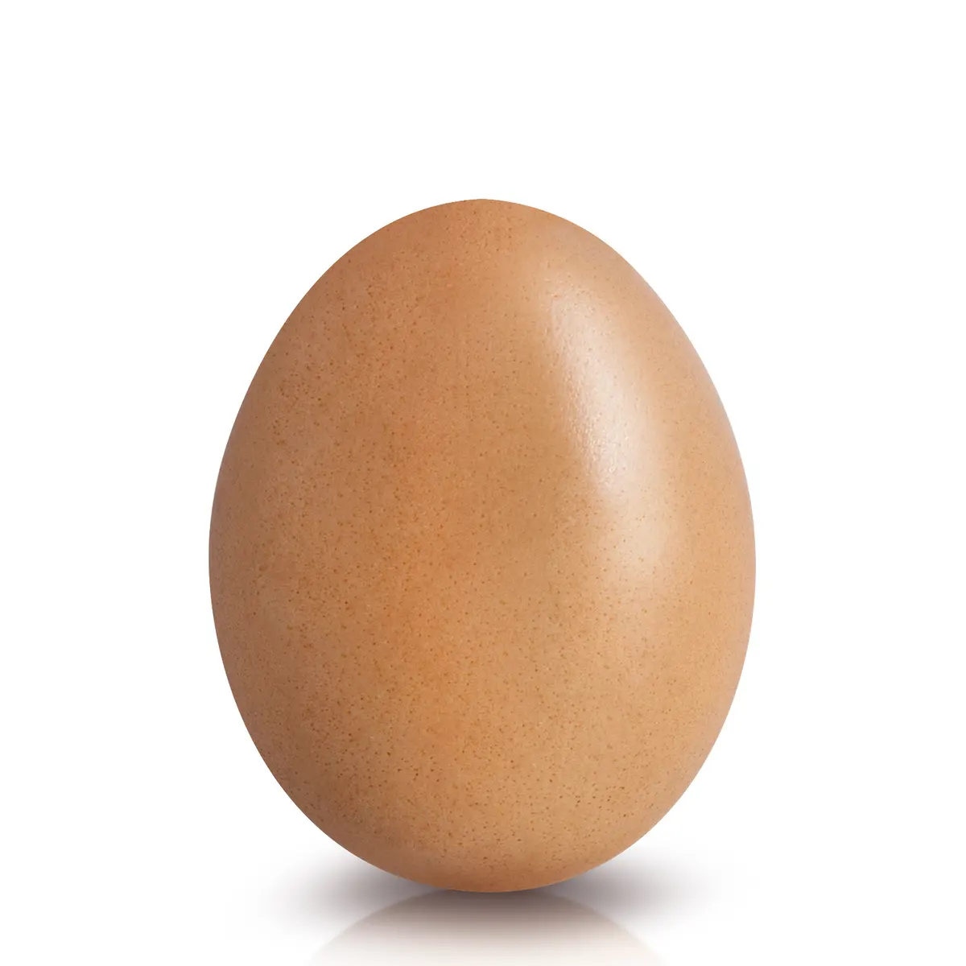
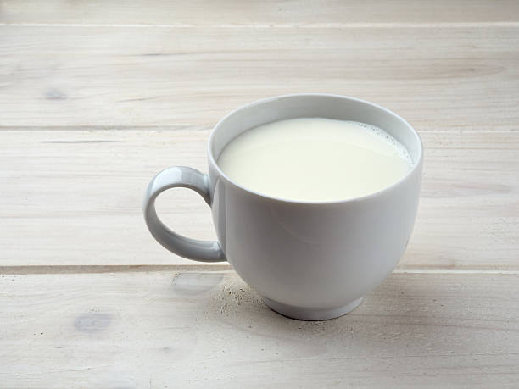
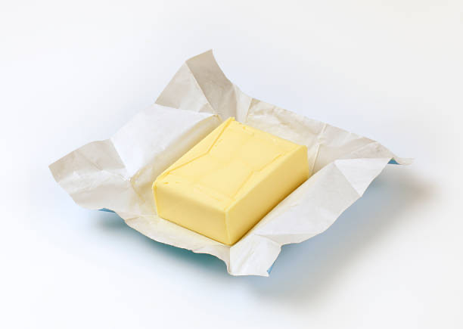
Pancake Recipe
I cup of flour |  | 1 egg
1 cup of milk |  | Knob of butter
Add the flour into a bowl
Pour in the milk and an egg
Heat the oil or butter in a frying pan
Pour in the batter
Fry on 1 side
Fry on other side
Serve with sugar and lemon

